Slide 1





UNDERSTANDING
STUDENT DEPRESSION
Descriptive Analysis performed by Mbuba Chiagozie Tochukwu & Mariam Adepoju

Slide 2

OBJECTIVE
This analysis investigates the contributing factors to student depression using survey data from over 28,000 students gotten from a Kaggle Dataset of students based in the United States. It explores how variables such as sleep hours, academic pressure, dietary habits, financial stress, and study hours correlate with depression levels.

Slide 3


HIGH LEVEL INSIGHTS
Depression Rate: 58.52% of students in the dataset reported experiencing depression.
Suicidal Rate: A staggering 63.27%, signaling serious mental health risks.
TOP CONTRIBUTING FACTORS:
Academic Pressure
Financial Stress
Poor
Sleep
Low Study Satisfaction

Slide 4
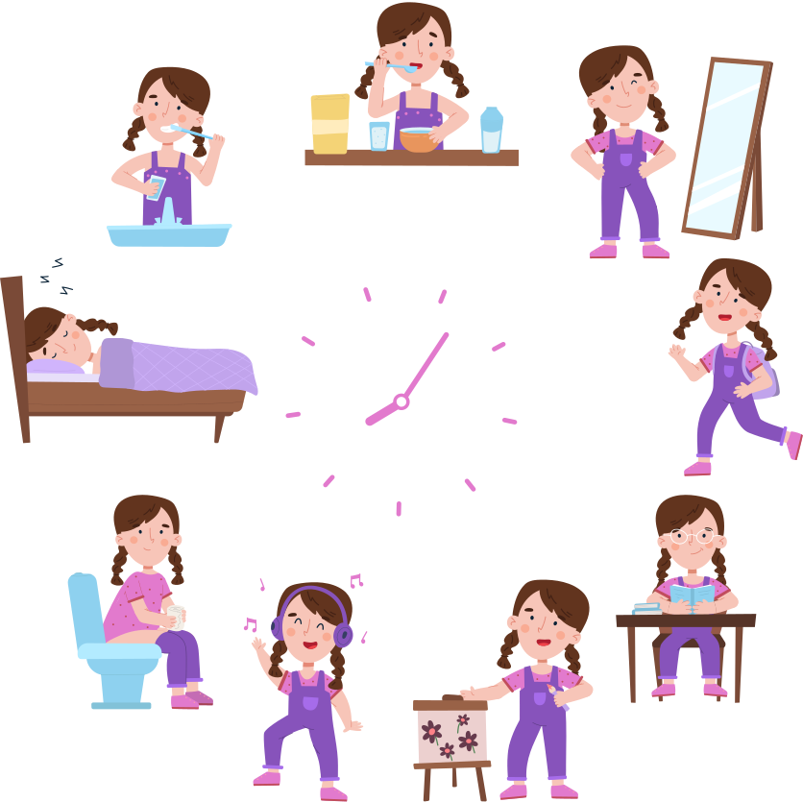
KEY FINDINGS
SLEEP AND STUDY PATTERNS
Students average 6.38 hours of sleep and 7.16 hours of study per day.
Despite decent CGPA scores (avg. 7.66), high suicidal and depression rates suggest grades are not a buffer for mental health.

Slide 5

KEY FINDINGS
2. ACADEMIC PRESSURE
Pressure is significantly higher among male students.
Cities like Kalyan and Hyderabad show the highest number of depressed students.
There is a direct correlation between higher academic pressure and increased depression.

Slide 6

KEY FINDINGS
3. FINANCIAL STRESS
Over 12,000 students reported financial stress, strongly associated with depression.
Financially stressed students are more likely to report suicidal tendencies.

Slide 7

KEY FINDINGS
4. DIET AND LIFESTYLE
Students with unhealthy dietary habits are more represented among those suffering from depression.
Those with a family history of mental illness show higher depression rates, particularly among females.

Slide 8

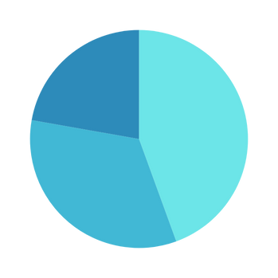

DEMOGRAPHIC TRENDS
Age Group 18–25 has the highest depression count (9.4K students), followed by the 26–35 group.
More females (9K) report depression compared to males (7K).
Depression rates vary by city, with Kalyan, Hyderabad, and Srinagar leading.

Slide 9




DATA DRIVEN RECOMMENDATIONS
Mental Health Support
Institutions should deploy targeted counseling for high-risk groups (18–25 years, financially stressed, and high academic pressure).
Academic Workload Reform
Redesign curricula to reduce burnout and introduce flexible deadlines or modular coursework.
Provide accessible scholarships, emergency funds, and budgeting workshops.
Financial Aid Programs
Promote healthy eating, sleep hygiene, and digital detox routines.
Health & Wellness Campaigns

Slide 10
FINAL NOTE
This analysis not only uncovers the alarming prevalence of depression but also empowers educators and policymakers with actionable insights.
The goal is simple: support students holistically, beyond grades and classes.

Slide 11
THANK YOU
Thank you for your attention and participation. Hopefully this information is useful for increasing awareness of mental health

